Slide 1
Plenary Session 3 – PART A Bioeconomy Innovations, Markets & Consumers
Contribution of balanced amino-acid supplementation in animal feeding to the climate and sustainability
Hiroyuki Kojima, Ph.D.
Chief Innovation Officer, Ajinomoto Co., Inc.
November 19, 2020

Slide 2
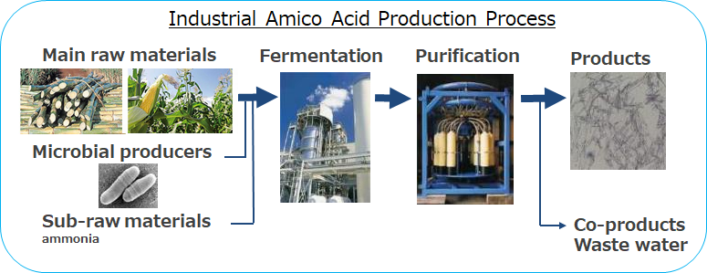

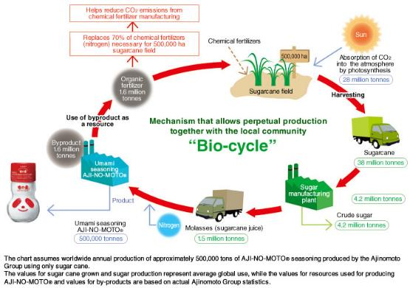


Production of Amino Acids and Bioeconomy
1. Nutritional Benefit
2. Taste Benefit
3. Health Benefits
1. Global market: >20 billion USD
2. >6% Increase estimated until 2027
1. Feed amino acid market: >5 billion USD
2. Feed amino acid production: >5 million tons

Slide 3
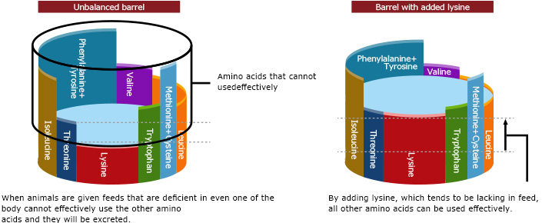
Importance of Balanced Amino Acid in feed
Water Resources and Industry 21, 100108. 2019.

Slide 4
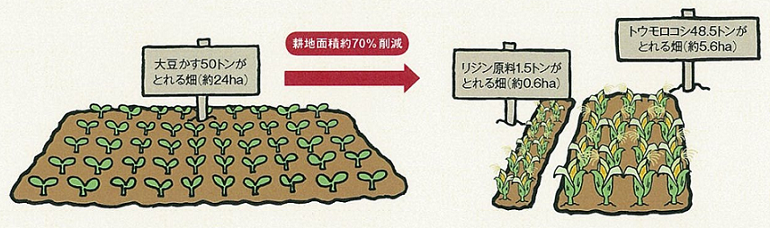
Conservation of natural protein sources and effective use of farmland
Normal Diet
Low Protein Diet
Others
Others
Soy Bean Meal
250mt
Soy Bean Meal
200mt
Lysine 1.5 mt
Nutritionally equivalent for animals
Corn
748.5mt
Corn
700mt
70% Reduction
48.5 mt Corn; 5.6 ha
50 mt SBM; 24 ha
Raw ingredient for 1.5 mt Lys ; 0.6 ha
24 - (5.6 +0.6) = 17.8 ha
Saving 17.8 ha farmland by 1.5 mt lysine
Saving 12 ha farmland
by using 1 mt lysine
4

Slide 5
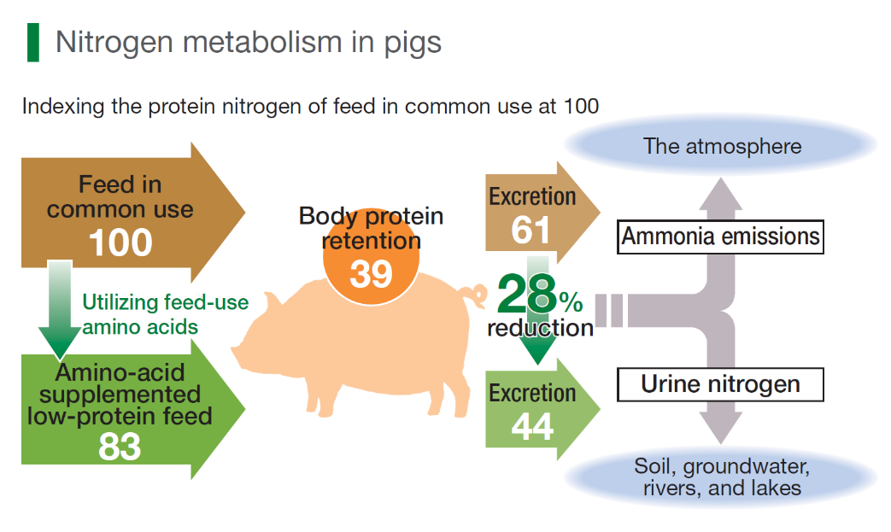
Reduction of protein levels and the associated nitrogen excretion
Water Resources and Industry 21, 100108. 2019.

Slide 6
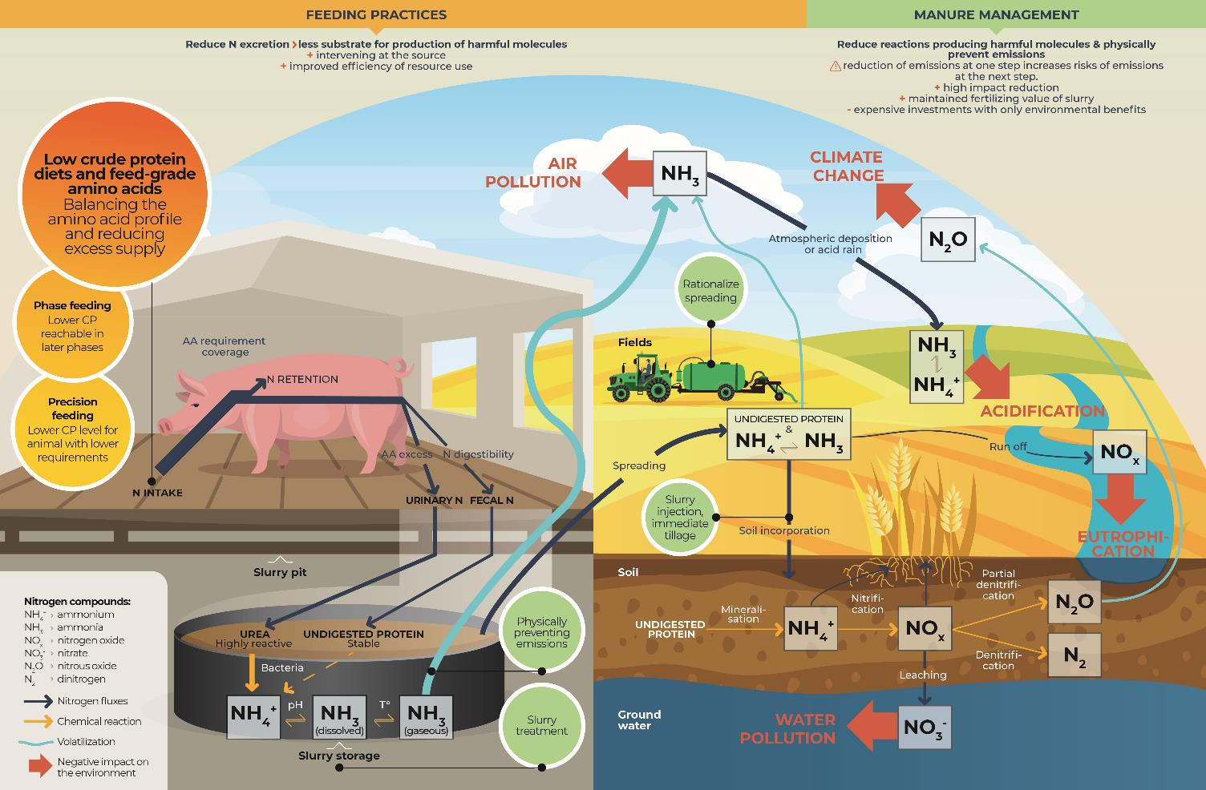
Solving Environmental Problems
Ajinomoto Animal Nutrition Europe

Slide 7
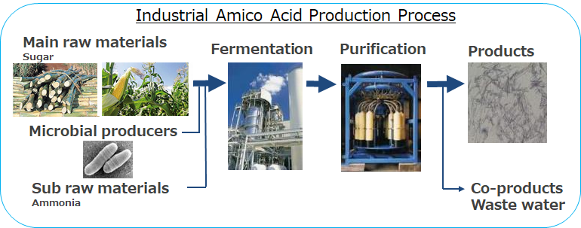
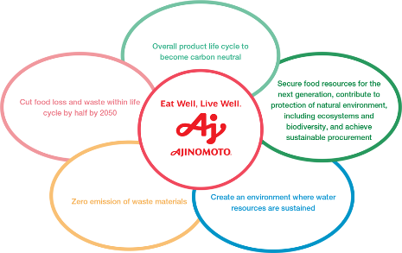




For More Sustainable Amino Acid Production and Future
Ajinomoto Group’s long-term environmental targets
Gasification
Catalytic reaction
Carbon
H₂O
H₂
Ammonia
(NH₃)
Wood chip
Air
N₂
Ammonia on site production

Slide 8
Thank you.

